Slide 1

Predictive Modeling of Bike Rental Demand Based on Weather and Seasonal Factors
Student Name-
Student ID-

Slide 2

Introduction
The project title is "Predictive Modeling of Bike Rental Demand Based on Weather and Seasonal Factors."
The study focuses on analyzing historical data from the Capital Bikeshare system.
Machine learning and time series techniques were used to forecast bike rental demand.
The aim is to provide insights for improving operational efficiency and user satisfaction.

Slide 3

Problem
Urban bike-sharing systems struggle to meet dynamic demand influenced by weather and seasons.
Imbalanced bike availability at stations reduces user satisfaction and operational effectiveness.
The inability to accurately predict bike demand limits infrastructure and resource optimization.
This research seeks to answer key questions about factors influencing rental patterns.
Specifically, it investigates the accuracy of forecasting demand based on weather and contextual data.

Slide 4

Solution
Predictive modeling using machine learning and time series was employed to forecast bike rentals.
Advanced models, including Random Forest and XGBoost, addressed the complexity of demand drivers.
Temporal models like ARIMA/SARIMA captured seasonality and hourly demand variations.
Evaluation metrics ensured models were optimized for practical, actionable predictions.
Insights were derived for improving bike redistribution and enhancing user satisfaction.

Slide 5
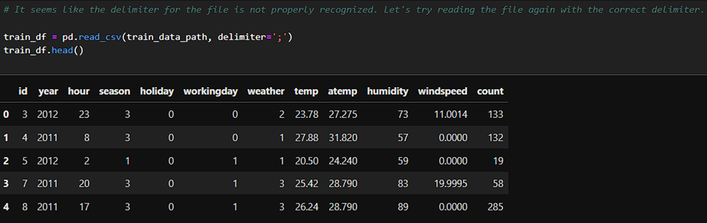
Data Overview and Preprocessing
Data was sourced from the Capital Bikeshare system, covering hourly and daily rentals.
Features included temperature, humidity, wind speed, holidays, seasons, and working days.
Preprocessing steps included cleaning missing values and encoding categorical variables.
Numerical features, such as temperature, were standardized for consistent model performance.
The dataset was split into training (80%) and testing (20%) subsets for validation.

Slide 6
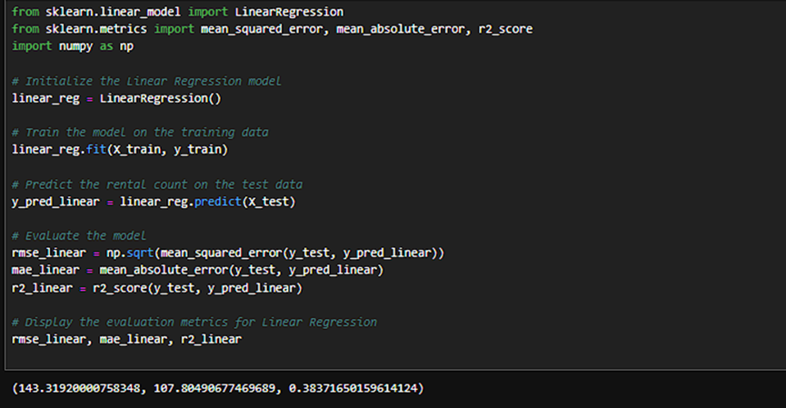
Model Development – Linear Regression
Linear Regression was implemented as a baseline for comparison against advanced models.
This model assumed a linear relationship between weather features and rental counts.
Training involved minimizing residuals to achieve the best-fit predictive model.
Despite simplicity, it struggled to capture non-linear patterns in bike rental demand.
Evaluation revealed significant prediction errors, with an R² score of only 0.38.

Slide 7
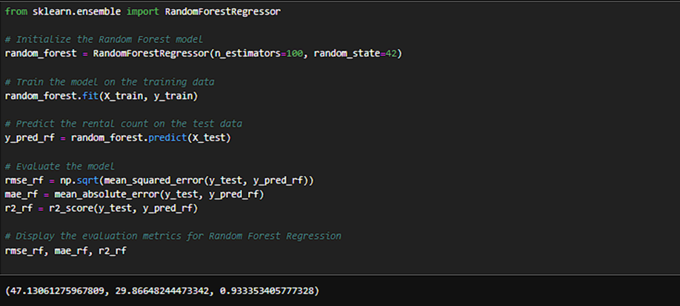
Model Development – Random Forest Regression
Random Forest Regression was employed to address non-linear relationships in rental demand.
The ensemble approach aggregated predictions from multiple decision trees for higher accuracy.
Hyperparameters, including tree depth and estimators, were tuned to optimize performance.
This model excelled at handling feature interactions, yielding an R² score of 0.93.
Random Forest emerged as the most robust predictor, with the lowest RMSE and MAE values.

Slide 8
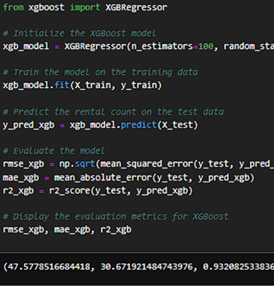
Model Development – XGBoost Regression
XGBoost Regression utilized gradient boosting to iteratively minimize prediction errors.
Hyperparameter tuning included adjusting learning rate, tree depth, and boosting rounds.
The model performed comparably to Random Forest, with an R² score of 0.93.
XGBoost was computationally efficient and captured complex feature interactions effectively.
While slightly less accurate than Random Forest, it demonstrated robustness and scalability.

Slide 9
Model Development – Time Series Models (ARIMA and SARIMA)
ARIMA and SARIMA were implemented to analyze temporal patterns in bike rentals.
Parameters like (p, d, q) were optimized based on autocorrelation and seasonality analysis.
SARIMA accounted for seasonal variations, improving performance on hourly rental data.
These models performed well for trends but lacked feature integration like machine learning.
Time series models complemented machine learning by focusing on temporal demand patterns.

Slide 10
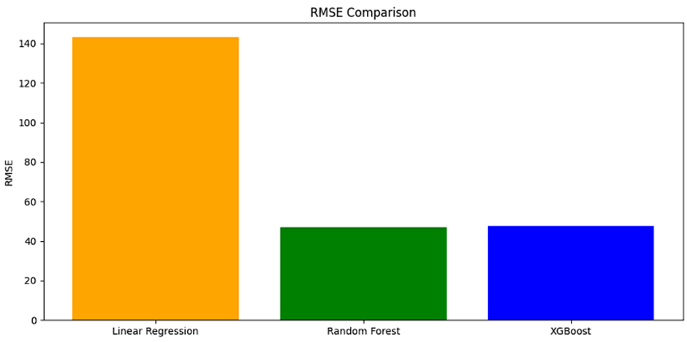
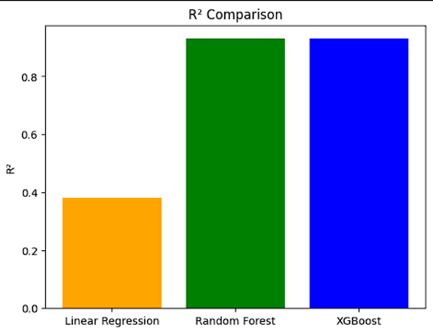
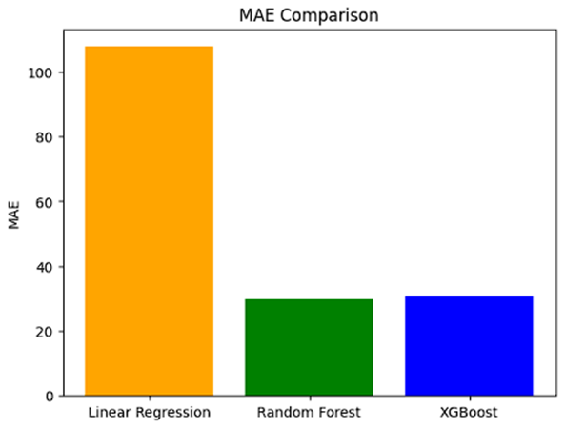
Model Comparison and Evaluation
Linear Regression had the weakest performance, with an R² score of 0.38 and high errors.
Random Forest achieved the best accuracy, with RMSE of 47.13 and MAE of 29.87.
XGBoost closely followed, with RMSE of 47.58 and MAE of 30.67, matching Random Forest’s R².
Time series models captured seasonality but lacked integration of key weather variables.
Random Forest emerged as the most reliable model for capturing demand complexities.

Slide 11
Results – Key Findings
Temperature, humidity, and wind speed were the most influential predictors of bike rentals.
Seasonal trends revealed higher demand during summer and lower usage in winter months.
Random Forest and XGBoost accurately predicted rental counts with minimal errors.
Spikes in demand occurred during commuting hours on working days, as expected.
Insights can guide resource allocation, bike redistribution, and infrastructure planning.

Slide 12

Practical Implications
Accurate demand forecasting improves operational efficiency and reduces bike shortages.
Resource allocation can be optimized based on predicted demand at specific stations.
Seasonal trends inform bike-sharing operators about infrastructure expansion opportunities.
Models support real-time adjustments to address fluctuations in demand patterns.
Enhancing user satisfaction through better service availability drives higher adoption rates.

Slide 13
Conclusion and Future Work
Random Forest and XGBoost proved highly effective for predicting bike rental demand.
Temporal models like SARIMA added value by identifying seasonal and hourly trends.
Insights from this study help improve urban mobility and sustainable transportation systems.
Future work includes integrating more weather variables and segmenting casual vs. registered users.
Advanced deep learning models, such as LSTMs, may further enhance predictive accuracy.

